Slide 1
Car Sales Dashboard Power BI
Presented by –
Anik Dey

Slide 2
Project Contents
Project Objectives
DAX Functions
KPIs
Dashboard Overview
Results & Interpretations

Slide 3
Agenda
01
02
03
04
05
06
Import Data on BI
Data Modelling
Data Transformation
Dax Functions
Identified KPIs
Graphical Representations

Slide 4

Project Objectives
Design and create a dynamic, interactive dashboard visualizing key sales KPIs.
Enhance understanding of historical and current sales performance.
Empower data-driven decisions for targeted growth and progress monitoring.

Slide 5
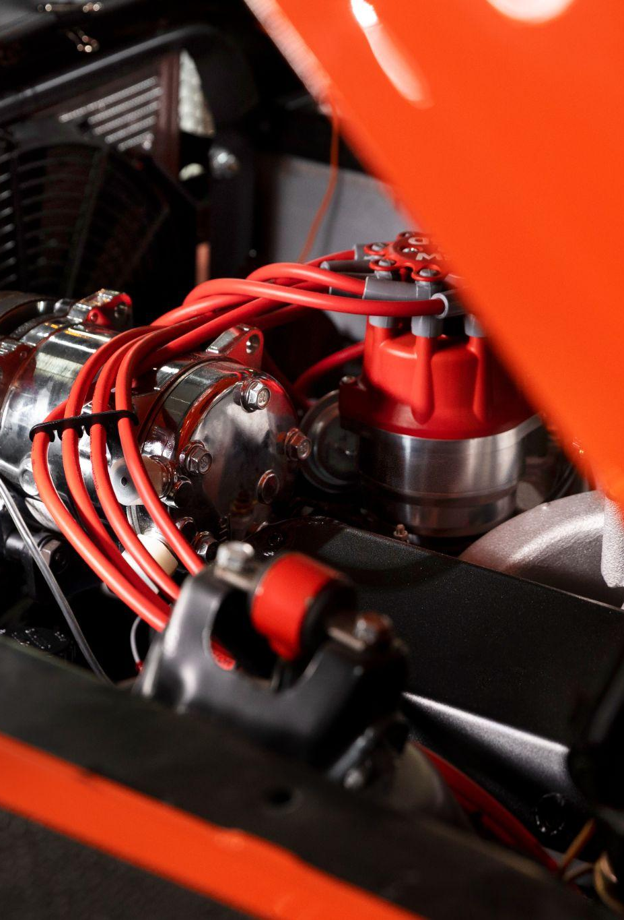
Total Sales Calculations – YTD Total Sales = TOTALYTD(SUM(car_data[Price ($)]),'Calender Table'[Date]) PYTD Total Sales = CALCULATE(SUM(car_data[Price ($)]),SAMEPERIODLASTYEAR('Calender Table'[Date])) Sales Difference = car_data[YTD Total Sales] - car_data[PYTD Total Sales] Sales Diff Colour = IF(car_data[Sales Difference]>0,"Green","Red") YOY Sales Growth = car_data[Sales Difference] / car_data[PYTD Total Sales] MTD Total Sales = TOTALMTD(SUM(car_data[Price ($)]),'Calender Table'[Date]) Average Price Calculations – AVG. Price = SUM(car_data[Price ($)]) / COUNT(car_data[Car_id]) YTD AVG Sales = TOTALYTD([AVG. Price],'Calender Table'[Date]) PYTD Average Price = CALCULATE([AVG.Price],SAMEPERIODLASTYEAR('Calender Table'[Date])) AVR Price Diff = [YTD AVG Sales] - [PYTD Average Price] AVG Price Colour = IF([AVR Price Diff]>0,"Green","Red") YOY AVG Price Growth = [AVR Price Diff] / [PYTD Average Price] MTD AVG Price = TOTALMTD([AVG. Price],'Calender Table'[Date])
DAX Functions

Slide 6
Car Sales Calculations – YTD Cars Sold = TOTALYTD(COUNT(car_data[Car_id]),'Calender Table'[Date]) PYTD Cars Sold =CALCULATE(COUNT(car_data[Car_id]),SAMEPERIODLASTYEAR('Calender Table'[Date])) DIFF Cars Sold = [YTD Cars Sold] - [PYTD Cars Sold] YOY Cars Sales = [DIFF Cars Sold] / [PYTD Cars Sold] MTD Cars Sales = TOTALMTD(COUNT(car_data[Car_id]),'Calender Table'[Date]) Creating Table as Calendar Date - Calendar Table = CALENDAR(MIN(car_data[Date]),MAX(car_data[Date]))
DAX Functions

Slide 7
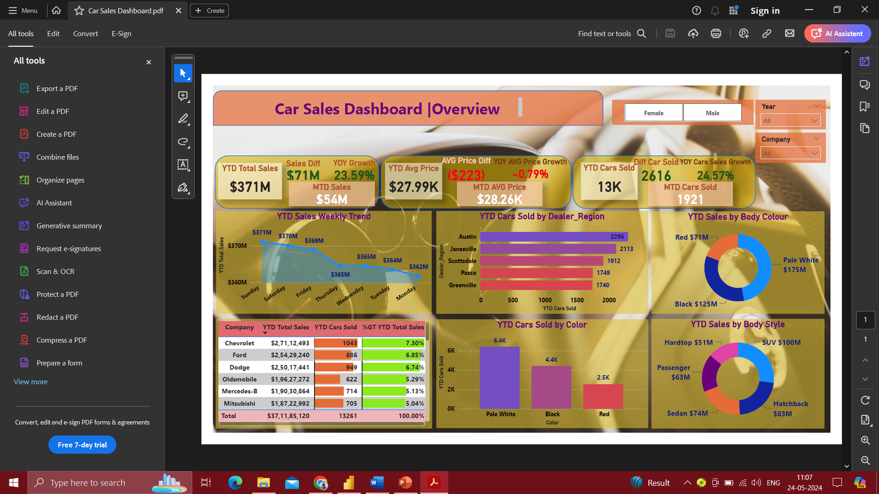
Dashboard Overview

Slide 8
Results & Interpretations
KPIs Interpretations
Toal Sales
Average Price
Cars Sales
1. YTD Total Sales – Current year total sales is 371Millions. 2. Sales Difference – Sales difference between Current year and previous year is 71 M. 3. YOY Sales Growth (%) – Year over year growth percentage is around 23.59% i.e. there is an increase in growth.
1.YTD Average Price – Year to Date average price of each car is around 27.99K Dollar. 2.Average Price Difference – Average price difference of each car in the current year from the previous year is -223K Dollar.
3.YOY Average Price Growth (%) – Year over year average price growth percentage of each car is -0.79%.
4.MTD Average Price – Month to date average price of each car is around 28.26K Dollar.
1.YTD Cars Sales = Year to date sales of the car is around 13K.
2.Difference in Cars Sales – There is an increase in the car sales around 2616 cars compared to the previous year cars sold.
3.YOY Cars Sales Growth (%) – Year over year cars sales growth percentage is increase by 24.57%.
4.MTD Cars Sales – Month to date cars sales is around 1921 cars.

Slide 9
Charts Interpretations
YTD Sales Weekly Trend
YTD Sales by Dealer Region
YTD Sales by Body Color
This area line chart makes it quite evident that Sundays have the largest sales so far this year, followed by Saturdays, and so on.
The dealer region named Austin has the biggest sales year to date, followed by Janesville, Scottsdale, and so on.
The car body color that has had the biggest sales year to date is pale white, which is followed by black and then red.
Table Matrix
YTD Car Sold by Colors
YTD Sales by Body Style
In the table, I want to include graphical representations of the datasets for the companies with the largest YTD Sales, highest YTD Sales in Cars, and greatest %GT YTD Total Sales.
This bar graph makes it evident which automobiles are the most popular so far this year: pale white cars, followed by black and then red cars.
From this Donut chart, it is clearly visible that cars with SUV body style have the largest year to date sales followed by Hatchback cars and so on.

Slide 10
Thnak You

